Slide 1
ELECTRONIC CIRCUITS
-Ramya .Srikanteswara , Department OF CSE,NMIT

Slide 2
Semiconductor-An element with electrical properties between those of a conductor and an insulator.
Ex : Silicon , Germanium
Intrinsic Semiconductor –Pure semiconductor
Extrinsic Semiconductor-Doped semiconductor
N type semiconductor- Silicon that has been doped with a pentavalent impurity
P type semiconductor-Silicon that has been doped with a trivalent impurty
Barrier Potential- Each dipole has an electric field between the positive and negative ions.The electric field between the ions is equivalent to a difference of potential called the barrier potential. 0.3 v-> Germanium , 0.7 v -> silicon

Slide 3

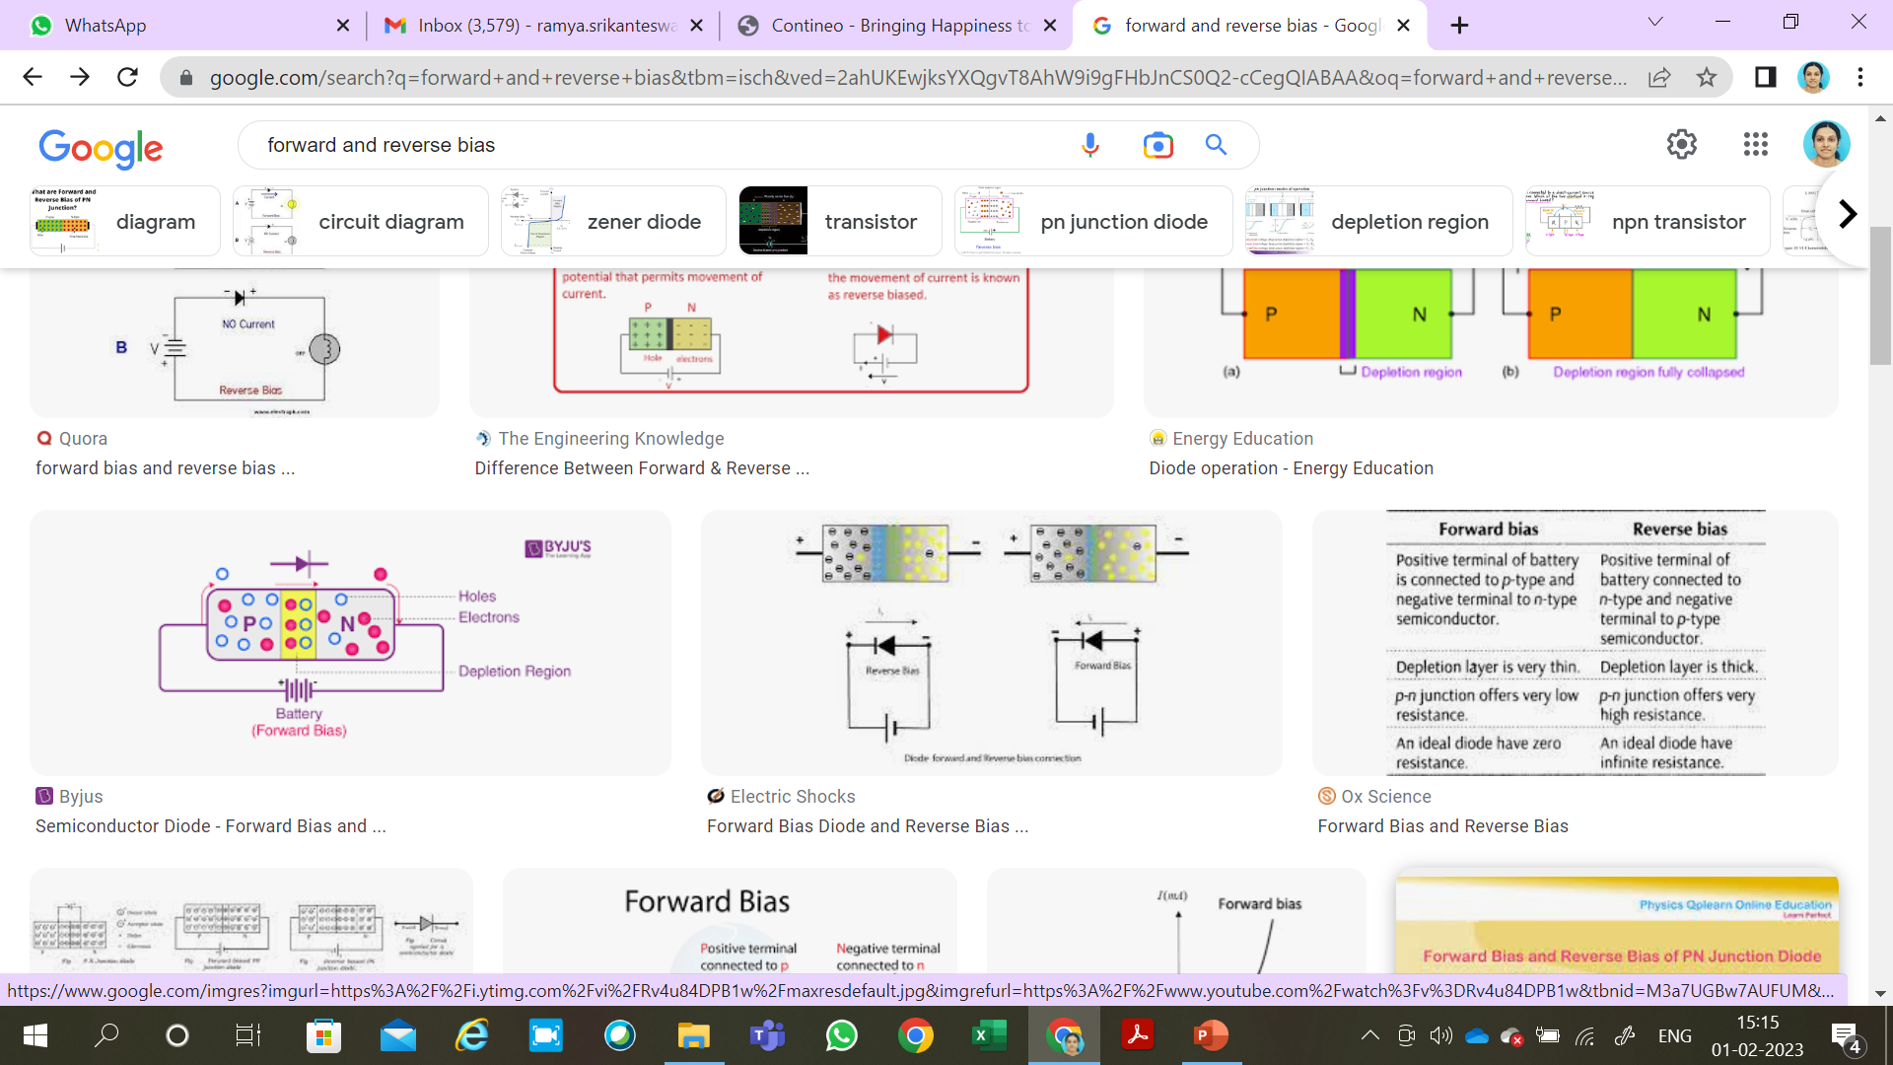
Forward bias and Reverse bias

Slide 4
INTRODUCTION
Ordinary resistor is a linear device , whereas diode is a non linear device .
When the diode voltage is less than the barrier potential , the diode current is small.
When the diode voltage exceeds the barrier potential, the diode current increases rapidly.

Slide 5
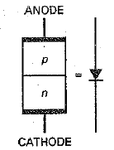
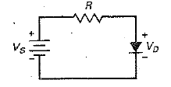

Slide 6
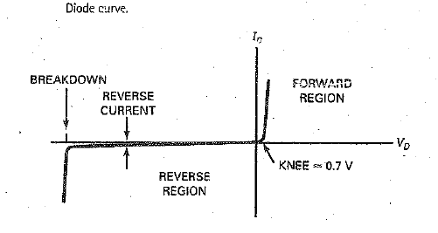
-Ramya .Srikanteswara , Department OF CSE,NMIT

Slide 7
Forward Region
Knee voltage
Bulk Resistance
Maximum DC forward current
Power Dissipation
-Ramya .Srikanteswara , Department OF CSE,NMIT

Slide 8
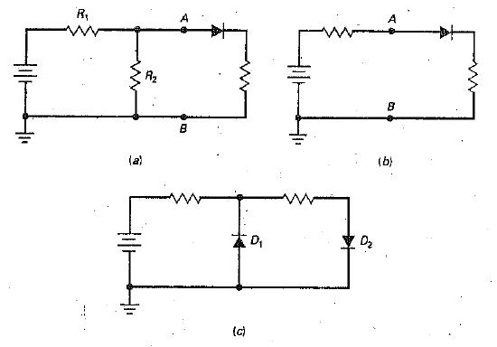
EXAMPLE 3.1 Is the diode forward or reverse biased ?
-Ramya .Srikanteswara , Department OF CSE,NMIT

Slide 9
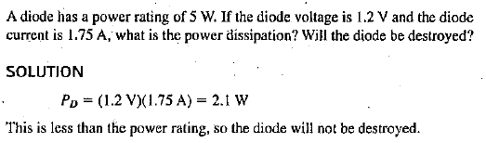
EXAMPLE 3.2
-Ramya .Srikanteswara , Department OF CSE,NMIT

Slide 10
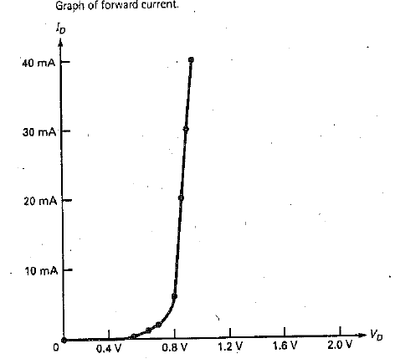
Ideal diode
-Ramya .Srikanteswara , Department OF CSE,NMIT

Slide 11
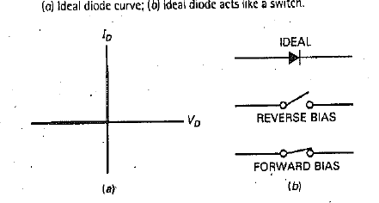
-Ramya .Srikanteswara , Department OF CSE,NMIT

Slide 12
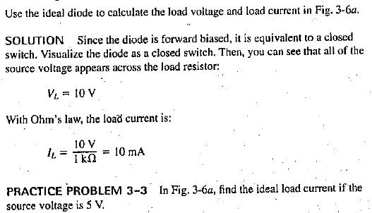
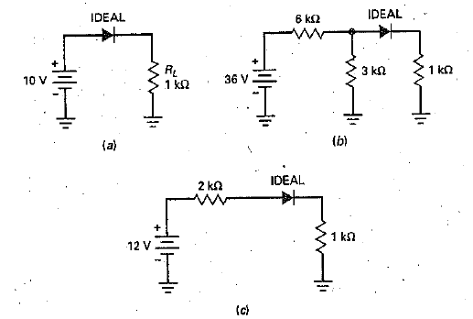
Example 3.3

Slide 13
Example 3.4
-Ramya .Srikanteswara , Department OF CSE,NMIT

Slide 14
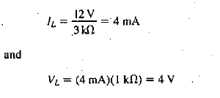
Thevenin’s resistance =6X3/6+3 = 2K ohms
Thevenin’s current = 36 v/9 k ohms = 4 mA
-Ramya .Srikanteswara , Department OF CSE,NMIT

Slide 15
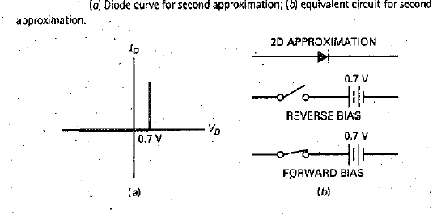
Second Approximation
-Ramya .Srikanteswara , Department OF CSE,NMIT

Slide 16
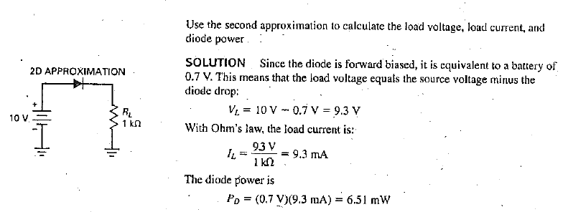
Example 3.5
-Ramya .Srikanteswara , Department OF CSE,NMIT

Slide 17
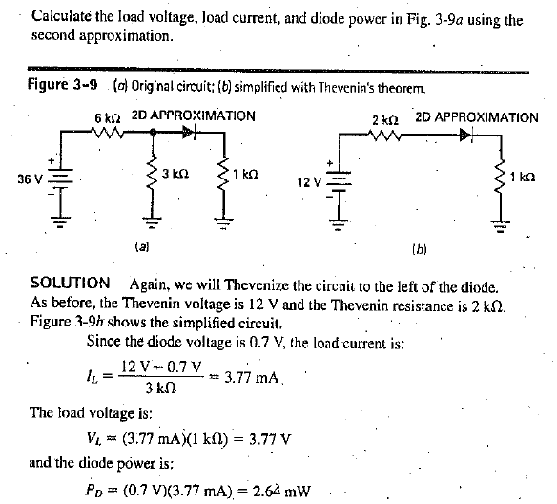
Example 3.6

Slide 18
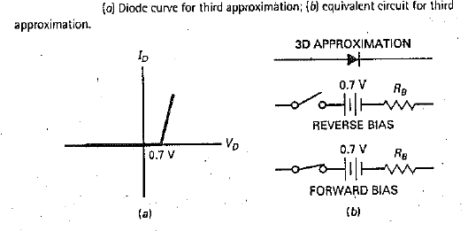

Third Approximation

Slide 19
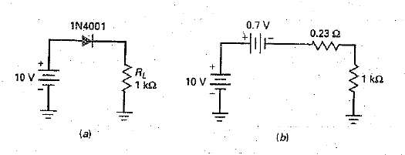
Example 3.7
-Ramya .Srikanteswara , Department OF CSE,NMIT

Slide 20
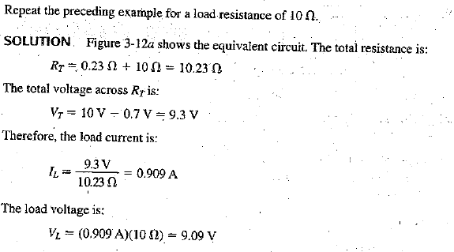
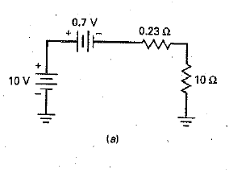
Example 3.8

Slide 21
Clippers and Limiters
The diodes used in low-frequency power supplies are rectifier diodes.
These diodes are optimized for use at 60 Hz and have power ratings greater than 0.5 W.
The typical rectifier diode has a forward current rating in amperes.
Except for power supplies, rectifier diodes have little use because most circuits inside electronics equipment are running at much higher frequencies.

Slide 22
Small-Signal Diodes
In this section, we will be using small-signal diodes.
These diodes are optimized for use at high frequencies and have power ratings less than 0.5 W.
The typical small-signal diode has a current rating in milliamperes.
It is this smaller and lighter construction that allows the diode to work at higher frequencies.
-Ramya .Srikanteswara , Department OF CSE,NMIT

Slide 23
The Positive Clipper
A clipper is a circuit that removes either positive or negative parts of a waveform.
This kind of processing is useful for signal shaping, circuit protection, and communications.
Figure 4-24a shows a positive clipper.
The circuit removes all the positive parts of the input signal.
This is why the output signal has only negative half-cycles.

Slide 25
Here is how the circuit works
During the positive half-cycle, the diode turns on and looks like a short across the output terminals.
Ideally, the output voltage is zero.
On the negative half-cycle, the diode is open.
In this case, a negative half-cycle appears across the output.
By deliberate design, the series resistor is much smaller than the load resistor.
This is why the negative output peak is shown as 2Vp in Fig. 4-24a.

Slide 26
To a second approximation, the diode voltage is 0.7 V when conducting.
Therefore, the clipping level is not zero, but 0.7 V.
For instance, if the input signal has a peak value of 20 V, the output of the clipper will look like Fig. 4-24b.
-Ramya .Srikanteswara , Department OF CSE,NMIT

Slide 27
Defining Conditions
Small-signal diodes have a smaller junction area than rectifier diodes because they are optimized to work at higher frequencies.
As a result, they have more bulk resistance.
The data sheet of a small-signal diode like the 1N914 lists a forward current of 10 mA at 1 V.
Therefore, the bulk resistance is:
-Ramya .Srikanteswara , Department OF CSE,NMIT

Slide 28
Why is bulk resistance important?
Because the clipper will not work properly unless the series resistance RS is much greater than the bulk resistance.
Furthermore, the clipper won’t work properly unless the series resistance RS is much smaller than the load resistance. For a clipper to work properly, we will use this definition:
-Ramya .Srikanteswara , Department OF CSE,NMIT

Slide 29
stiff clipper
This says that the series resistance must be 100 times greater than the bulk resistance and 100 times smaller than the load resistance.
When a clipper satisfies these conditions, we call it a stiff clipper.
For instance, if the diode has a bulk resistance of 30 V, the series resistance should be at least 3 kV and the load resistance should be at least 300 kV.

Slide 30
The Negative Clipper
If we reverse the polarity of the diode as shown in Fig. 4-25a, we get a negative clipper , that would remove the negative parts of the signal.
Ideally , the output waveform has nothing but positive half-cycles.
The clipping is not perfect.
Because of the diode offset voltage (another
way of saying barrier potential), the clipping level is at -0.7 V.
If the input signal has a peak of 20 V, the output signal will look like Fig. 4-25b.

Slide 31
-Ramya .Srikanteswara , Department OF CSE,NMIT

Slide 32
The Limiter or Diode Clamp
The clipper is useful for wave shaping, but the same circuit can be used in a totally different way.
Take a look at Fig. 4-26a. The normal input to this circuit is a signal with a peak of only 15 mV.
Therefore, the normal output is the same signal because neither diode is turned during the cycle.

Slide 33
-Ramya .Srikanteswara , Department OF CSE,NMIT

Slide 34
Whenever you have a sensitive circuit, one that cannot have too much input, you can use a positive negative limiter to protect its input, as shown in Fig. 4-26b.
If the input signal tries to rise above 0.7 V, the output is limited to 0.7 V.
On the other hand, if the input signal tries to drop below -0.7 V, the output is limited to 0.7 V.
In a circuit like this, normal operation means that the input signal is always smaller than 0.7 V in either polarity.

Slide 35
A more familiar example of a sensitive circuit is a moving-coil meter.
By including a limiter, we can protect the meter movement against excessive input voltage or current.
The limiter of Fig. 4-26a is also called a diode clamp.
The term suggests clamping or limiting the voltage to a specified range.
With a diode clamp, the diodes remain off during normal operation.
The diodes conduct only when something is abnormal, when the signal is too large.

Slide 36
Biased Clippers
The reference level (same as the clipping level) of a positive clipper is ideally zero, or 0.7 V to a second approximation. What can we do to change this reference level?
In electronics, bias means applying an external voltage to change the reference level of a circuit.
Figure 4-27a is an example of using bias to change the reference level of a positive clipper.

Slide 37
-Ramya .Srikanteswara , Department OF CSE,NMIT

Slide 38
By adding a dc voltage source in series with the diode, we can change the clipping level.
The new V must be less than Vp for normal operation.
With an ideal diode, conduction starts as soon as the input voltage is greater than V.
To a second approximation, it starts when the input voltage is greater than V + 0.7 V.
Figure 4-27b shows how to bias a negative clipper. Notice that the diode
and battery have been reversed. Because of this, the reference level changes to V - 0.7 V.
The output waveform is negatively clipped at the bias level.

Slide 39
Combination Clipper
We can combine the two biased clippers as shown in Fig. 4-28.
Diode D1 clips off positive parts above the positive bias level, and diode D2 clips off parts below the negative bias level.
When the input voltage is very large compared to the bias levels, the output signal is a square wave, as shown in Fig. 4-28.
This is another example of the signal shaping that is possible with clippers.

Slide 40
-Ramya .Srikanteswara , Department OF CSE,NMIT

Slide 41
Variations
Using batteries to set the clipping level is impractical.
One approach is to add more silicon diodes because each produces a bias of 0.7 V.
For instance, Fig. 4-29a shows three diodes in a positive clipper.
Since each diode has an offset of around 0.7 V, the three diodes produce a clipping level of approximately +2.1 V.
The application does not have to be a clipper (wave shaping).
We can use the same circuit as a diode clamp (limiting) to protect a sensitive circuit that cannot tolerate more than a 2.1-V input.

Slide 42
-Ramya .Srikanteswara , Department OF CSE,NMIT

Slide 43
Figure 4-29b shows another way to bias a clipper without batteries.
This time, we are using a voltage divider (R1 and R2) to set the bias level.
The bias level is given by:
In this case, the output voltage is clipped or limited when the input is greater than V bias + 0.7 V.

Slide 44
Figure 4-29c shows a biased diode clamp.
It can be used to protect sensitive circuits from excessive input voltages.
The bias level is shown as +5 V.
It can be any bias level you want it to be.
With a circuit like this, a destructively large voltage of +100 V never reaches the load because the diode limits the output voltage to a maximum value of +5.7 V.

Slide 45
Sometimes a variation like Fig. 4-29d is used to remove the offset of the limiting diode D1.
Here is the idea: Diode D2 is biased slightly into forward conduction so that it has approximately 0.7 V across it.
This 0.7 V is applied to 1 kV in series with D1 and 100 kV.
This means that diode D1 is on the verge of conduction.
Therefore, when a signal comes in, diode D1 conducts near 0 V.

Slide 46
-Ramya .Srikanteswara , Department OF CSE,NMIT

Slide 47
Clampers
A clamper adds a dc voltage to the signal.
When a positive clamper has a sine-wave input, it adds a positive dc voltage to the sine wave.
Stated another way, the positive clamper shifts the ac reference level (normally zero) up to a dc level.
The effect is to have an ac voltage centered on a dc level.
This means that each point on the sine wave is shifted upward, as shown on the output wave.
-Ramya .Srikanteswara , Department OF CSE,NMIT

Slide 48
-Ramya .Srikanteswara , Department OF CSE,NMIT

Slide 49
Figure 4-30b shows an equivalent way of visualizing the effect of a positive clamper.
An ac source drives the input side of the clamper.
The Thevenin voltage of the clamper output is the superposition of a dc source and an ac source.
The ac signal has a dc voltage of Vp added to it.
This is why the entire sine wave of Fig. 4-30a has shifted upward so that it has a positive peak of 2Vp and a negative peak of zero.

Slide 50
Figure 4-31a is a positive clamper.
Ideally, here is how it works.
The capacitor is initially uncharged.
On the first negative half-cycle of input voltage, the diode turns on (Fig. 4-31b).
At the negative peak of the ac source, the capacitor has fully charged and its voltage is Vp with the polarity shown.
-Ramya .Srikanteswara , Department OF CSE,NMIT

Slide 51
Slightly beyond the negative peak, the diode shuts off (Fig. 4-31c).
The RLC time constant is deliberately made much larger than the period T of the signal.
We will define much larger as at least 100 times greater:
-Ramya .Srikanteswara , Department OF CSE,NMIT

Slide 52
The idea is similar to the way a half-wave rectifier with a capacitor-input filter works.
The first quarter-cycle charges the capacitor fully.
Then, the capacitor retains almost all of its charge during subsequent cycles. The small charge that is lost between cycles is replaced by diode conduction.
In Fig. 4-31c, the charged capacitor looks like a battery with a voltage of Vp. This is the dc voltage that is being added to the signal.
After the first quarter cycle, the output voltage is a positively clamped sine wave with a reference level of zero; that is, it sits on a level of 0 V.
-Ramya .Srikanteswara , Department OF CSE,NMIT

Slide 53
Figure 4-31d shows the circuit as it is usually drawn.
Since the diode drops 0.7 V when conducting, the capacitor voltage does not quite reach Vp.
For this reason, the clamping is not perfect, and the negative peaks have a reference level of 20.7 V.
-Ramya .Srikanteswara , Department OF CSE,NMIT

Slide 54
Negative Clamper
We get the negative clamper of Fig. 4-32.
As you can see, the capacitor voltage reverses, and the circuit becomes a negative clamper.
Again, the clamping is less than perfect because the positive peaks have a reference level of 0.7 V instead of 0 V.
As a memory aid, notice that the diode points in the direction of shift.
In Fig. 4-32, the diode points downward, the same direction as the shift of the sine wave.
This tells you that it’s a negative clamper.
-Ramya .Srikanteswara , Department OF CSE,NMIT

Slide 55
-Ramya .Srikanteswara , Department OF CSE,NMIT

Slide 56
Both positive and negative clampers are widely used.
For instance, television receivers use a clamper to change the reference level of video signals.
Clampers are also used in radar and communication circuits.
-Ramya .Srikanteswara , Department OF CSE,NMIT

Slide 57
PEAK TO PEAK DETECTOR
A half-wave rectifier with a capacitor-input filter produces a dc output voltage approximately equal to the peak of the input signal.
When the same circuit uses a small-signal diode, it is called a peak detector.
Typically, peak detectors operate at frequencies that are much higher than 60 Hz.
The output of a peak detector is useful in measurements, signal processing, and communications.

Slide 58
If you cascade a clamper and a peak detector, you get a peak-to-peak detector
As you can see, the output of a clamper is used as the input to a peak detector.
Since the sine wave is positively clamped, the input to the peak detector has a peak value of 2Vp.
This is why the output of the peak detector is a dc voltage equal to 2Vp.
-Ramya .Srikanteswara , Department OF CSE,NMIT

Slide 59
As usual, the RC time constant must be much greater than the period of the signal.
By satisfying this condition, you get good clamping action and good peak detection.
The output ripple will therefore be small.
-Ramya .Srikanteswara , Department OF CSE,NMIT

Slide 60
One application is in measuring nonsinusoidal signals.
An ordinary ac voltmeter is calibrated to read the rms value of an ac signal.
If you try to measure a nonsinusoidal signal, you will get an incorrect reading with an ordinary ac voltmeter.
However, if the output of a peak-to-peak detector is used as the input to a dc voltmeter, it will indicate the peak-to-peak voltage.
If the nonsinusoidal signal swings from 220 to 1 50 V, the reading is 70 V.
-Ramya .Srikanteswara , Department OF CSE,NMIT

